Slide 2

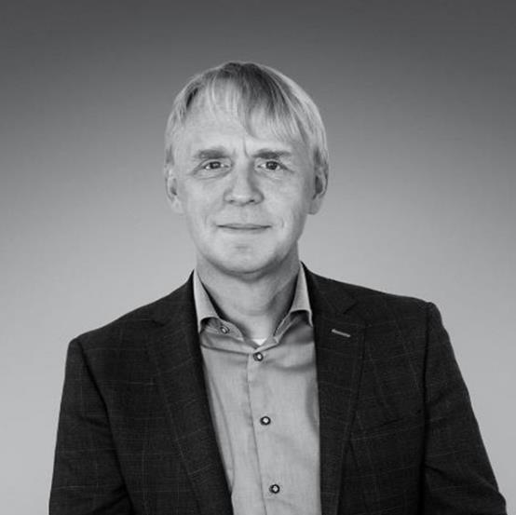

Improving people’s lives
“When I started this business, I had a vision of a company that would make a difference in the world.”
MAGNUS HÖGBERG
FOUNDER
Notes:
Purpose of the slide: To stage the feeling of stability, grounded know-how and business understanding.
Our origin is important, and we are proud of it. Magnus Högberg started the business 21 years ago with the vision ”to eliminate pressure ulcers together with caregivers”.
His work was the start that has led to where we are today, with world class products and a prosperous business and this vision…. is still our guiding star into the future!
Since Care of Sweden started in 1999, our vision has been to eliminate pressure ulcers and our brand has been built on a foundation of innovation, dedicated team members and a deep commitment to improving people’s lives.
We continue to take steps towards this vision with the aim to develop sustainable medical aids for healthcare.
Our products enable an individualised care for the users, and improved workload for caregivers and contributes to a good health economy.
Together we make it possible.

Slide 3
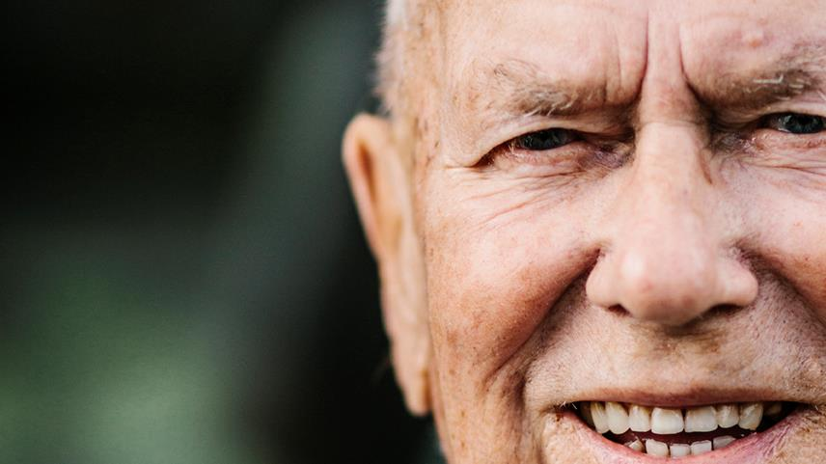

DEMOGRAPHICS
The World Health Organization , estimates that by 2050, the number of persons aged 80 years or older is expected to triple to reach
426 million
* World Health Organization. (2021) Ageing and health. Retrieved April 30, 2023 from https://www.who.int/news-room/fact-sheets/detail/ageing-and-health
Notes:
Globally:
According to the World Health Organization (WHO), the number of people over the age of 80 is expected to triple from 2020 to 2050. This trend is also reflected in (x country x), where the population aged 85 and above is projected to increase by 140% from xxx,xxx in xyearx, to x.xx million by xyear.
With this increase in the elderly population, there has been a corresponding increase in the demand for home care, with the number of people using such services having increased more than threefold from 2011 to 2021.With elderly people having a greater need for healthcare, there is corresponding increased demand for long-term care, with focus on person-centred care. To ensure a good quality of care for the elderly, the strategy needs to focus on maintaining the autonomy and dignity of these individuals. Older people often require more care, whether in hospitals or nursing homes, and are more likely to have chronic illnesses or need care for conditions such as dementia.
Questions that we need to consider is going forward is:
What consequences might this have in my local market?
What impact will this have on procurement?
How can we address this in terms of sales and marketing activities?

Slide 4

SHORTAGE OF HEALTHCARE PROFESSIONALS
The World Health Organization, estimates that by 2030, the world
will face a shortfall of health care workers, projected up to
10 million
* World Health Organization. (2023) Health workforce. Retrieved April 30, 2023, from https://www.who.int/health-topics/health-workforce#tab=tab_1
Notes:
Globally:
The World Health Organization (WHO) estimates that the world will face a projected shortfall of 10 million health workers by 2030, highlighting the urgent need for innovative solutions to address this critical issue. As healthcare demands continue to rise, especially in the face of global pandemics and chronic diseases, the availability of trained health workers is becoming increasingly scarce.
To address this challenge, there is a pressing need for technological solutions that can support health workers and improve their efficiency⁽¹⁾.
⁽¹⁾ Health workforce (who.int) https://www.who.int/health-topics/health-workforce#tab=tab_1

Slide 5
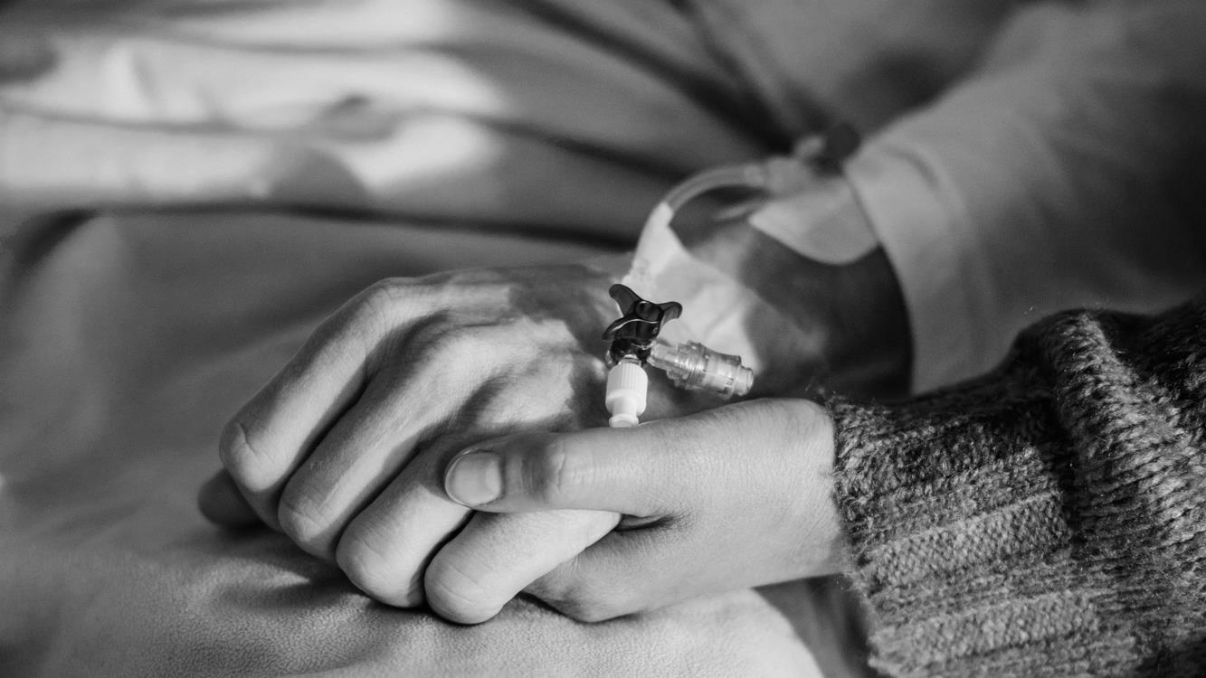
HEALTHCARE ASSOCIATED INFECTIONS
Up to 15%
In acute-care hospitals, will acquire at least one health care-associated infection during their hospital stay.
* WHO (2022). WHO launches first ever global report on infection and prevention control. Retrieved June 16th, 2023, from: https://www.who.int/news/item/06-05-2022-who-launches-first-ever-global-report-on-infection-prevention-and-control
Notes:
Globally:
Today, out of every 100 patients in acute-care hospitals, seven patients in high-income countries and 15 patients in low- and middle-income countries will acquire at least one health care-associated infection (HAI) during their hospital stay. On average, 1 in every 10 affected patients will die from their HAI (1)
•Healthcare associated infections (HAIs) can have significant impacts on the healthcare system. The World Health Organisation (WHO) recently released a global report on infection prevention and control, and the finding are quite alarming(1). Healthcare associated infections (HAIs) are a significant concern in healthcare settings, as they can lead to longer hospital stays, increased healthcare cost and even mortality in some cases(2).
•Patients with pressure injuries are particularly vulnerable to HAIs, as the damage skin provides a pathway for microorganisms to enter the body . These patients may have open wounds, making them more vulnerable to infections that can be transmitted through direct contact, contaminated surfaces, or medical devices(3).
(1)WHO launches first ever global report on infection prevention and control https://www.who.int/news/item/06-05-2022-who-launches-first-ever-global-report-on-infection-prevention-and-control
(2)National Pressure Ulcer Advisory Panel, European Pressure Ulcer Advisory Panel, & Pan Pacific Pressure Injury Alliance. (2019). Prevention and treatment of pressure ulcers: Clinical practice guideline. Emily Haesler (Ed.). EPUAP/NPUAP/PPPIA: Perth, Australia.
(3)Institute for Healthcare Improvement. (2019). Pressure injury prevention: Protecting patients from harm. Retrieved from https://www.ihi.org/Topics/PressureInjuryPrevention/Pages/default.aspx

Slide 6
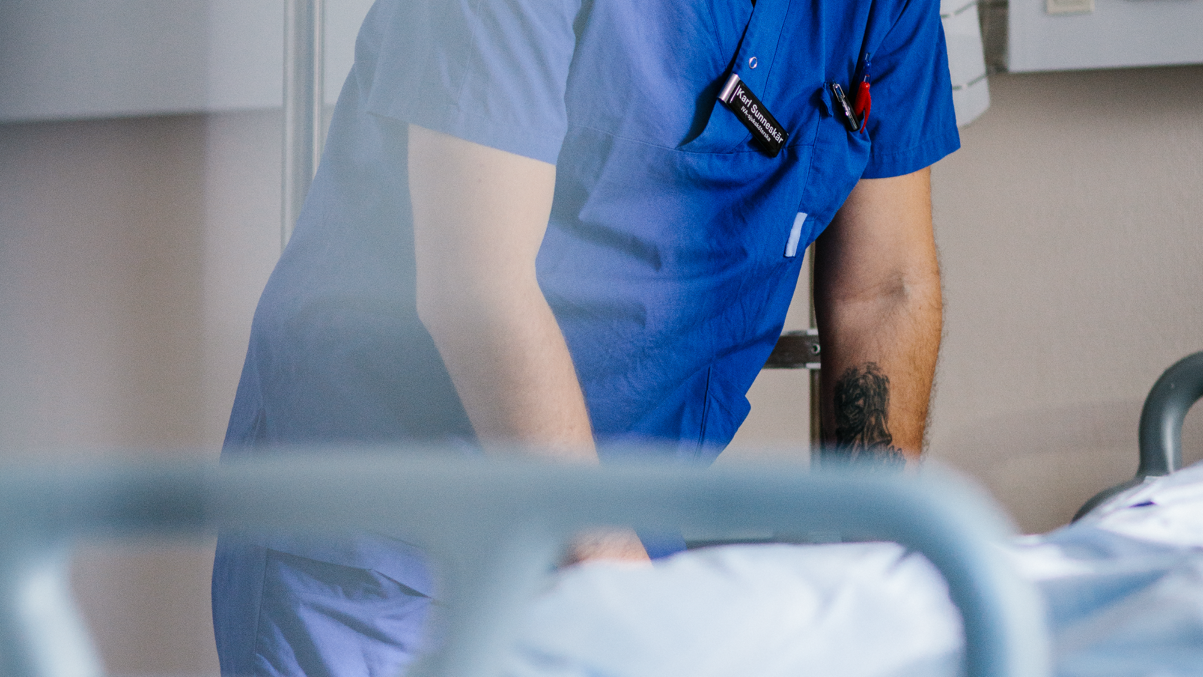

PRESSURE ULCERS
The estimated cost for treating pressure ulcers/pressure injuries
Australia
Public Hospitals
$9.11 billion*
Sweden
Inpatient Care
EUR 45 million*
UK
National Health Service
£2.1 billion*
* Pressure injuries in Australian public hospitals: A cost of illness study | * Bilaga 2: Vårddagskostnader för undvikbara trycksår – ett räkneexempel (socialstyrelsen.se) | * The cost of pressure ulcers in the UK - PubMed (nih.gov)
Notes:
•Pressure injuries, are a significant problem in healthcare, affecting millions of people worldwide. These injuries are often the result of prolonged pressure on the skin, which leads to tissue damage and can be difficult to treat. The impact of pressure ulcers on both individual patients and the broader healthcare system is significant, with increased costs and decreased quality of life.
•These injuries are particularly common among elderly patients, those with mobility issues, and those who are bedridden or in wheelchairs. Pressure ulcers are painful and can lead to serious complications, such as reduced mobility, depression, infection, sepsis, and even death.
In Australia/New Zealand:
•The cost of treating pressure injuries is also significant. Pressure injuries are a significant burden on the healthcare system in Australia, and they result in considerable healthcare costs. According to a report published in the International Journal of Nursing Studies, reports that the total cost for pressure injuries in Australian public hospitals was $9 .11 billion(1).
•
•The report also notes that the cost for pressure injuries are associated with longer hospital stays and treatment costs. Reducing preventable pressure injuries and stopping the progression of Stage 1 pressure injuries will likely result in an immense cost-saving for Australia(1).
•The estimated cost of pressure injuries in New Zealand is approximately NZD 694 million each year and approximately 55,000 people suffer from a PI in New Zealand every year(2).
(1)Pressure injuries in Australian public hospitals: A cost of illness study. https://reader.elsevier.com/reader/sd/pii/S0020748922000207?token=EE9E6F77238E1ED17E1E98ACB0FFE1F1A25E8F1F61BEB08D0F11AFDE8A02FB8F8ED091B701D982E7F75C2566714DBB6C&originRegion=eu-west-1&originCreation=20230224081951
(2)KPMG-pressure-injury-report-Jan-2016.pdf (hqsc.govt.nz) https://www.hqsc.govt.nz/assets/Our-work/System-safety/Reducing-harm/Pressure-injury/Publications-resources/KPMG-pressure-injury-report-Jan-2016.pdf
These challenges in the market are important to address while at the same time, they are making an opportunity in the market.
Would you like to explain that opportunity Sara?
Pressure ulcers are not only involved with unnecessary suffering, they are a significant burden on the healthcare system across the world in terms of cost.
Below you can see extracts from different markets and the annual cost of these within different care settings.
According to a report published in the International Journal of Nursing Studies, reports that the total cost for pressure injuries in Australian public hospitals was $9 .11 billion(1).
the National Board of Social Affairs and Health
study published in the national library of medicin, the cost of pressure ulcers in UK.
These challenges in the market are important to address while at the same time, they are making an opportunity in the market for the companies bold enough to address them.
Would you like to explain that opportunity Sara?

Slide 7


THE REASON WHY WE DEVELOPED PULSATION
Pressure injury etiology
Notes:
When a cause of a disease is determined this is called etiology.
Importance of sunlight in the etiology of melanoma.
3.
Syfte: Denna slide delar upp presentationen I olika kapitel och syftar till att tydliggöra övergången från ett kapitel till ett annat.
Explaine etiology
When a cause of a disease is determined this is called etiology.
Importance of sunlight in the etiology of melanoma.

Slide 8


CAUSES OF PRESSURE INJURIES
ISCHEMIA
(Slow process)
CELL
DEFORMATION
(Quick process)
Notes:
3b.
Ischemi & cell deformation – The conflict
As previously stated, there are two primary causes for PIs. Ischemia and cell deformation.
Ischemia is a slow process and a condition in which blood flow in the body tissue is reduced or restricted. When blood flow is restricted, the transport of oxygenated blood to the body, as well as the extraction of CO2 and waste products, is blocked (Lactate)
Direct cell deformation is a quick process and is essentially the breaking and bursting of the cell skeleton, rupture of the cell membrane causing cell fluid to leak, resulting in immediate tissue damage and death of surrounding tissue.
Alternating mattrasses are designed to create tissue perfusion by alternating the pressure, simulating micro movements and therefore stimulating the tissue. Alternating products are designed to fight ISCHEMIA.
Constant low pressure mattrasses are designed to be immersive and thus distribute pressure over a larger area - thus they are very effective in avoiding direct cell deformation from high peak pressures.
The conflict is that while using an alternating mattress helps to fight Ischemia, the high peak pressures can cause cell deformation. Cell deformation is a very fast process that can occur in a matter of minutes.
On the other hand, when you fight CD with CLP, you do not fight Ischemia.
To achieve a combination of immersion and tissue perfusion AND good comfort, Magnus ended up in artificial intelligence. To our knowledge, this is the only mattrass system on the market today that uses machine learning and adaptive
algorithms. CoS has spent nearly 20.000 hours developing and fine-tuning the software.
Pulsation is the result and the feature. With pulsation both I and CD are addressed. And the system autonomously changes the settings based on the patient's body weight, positioning, and movements. The result ? A comfortable and efficient
pressure injury prevention and confident support in pressure wound treatment.

Slide 9



WHY DID WE DEVELOP PULSATION?
2009
2012
2018
ISCHEMIA
PULSATION
CELL DEFORMATION
Notes:
3a.
In 2009, Magnus Högberg, the founder of Care of Sweden, embarked on a mission to revolutionize the status quo for bedridden patient’s comfort.
With the goal of improving the lives of those who require alternating mattresses, he set out to find a way to challenge the current industry standards, by combining the principles of Constant Low Pressure (CLP) and the alternating technology.
Around that time, back in 2009, the debate started around the root cause (the ethology) of pressure injuries. Until then, the widely known cause of pressure injuries was deemed to be Ischemia, or the blockage of blood flow.
But in 2012, a game-changer was introduced to the conversation as a second primary cause for pressure injuries, direct cell deformation.
Direct cell deformation is essentially the breaking and bursting of cell skeleton, rupture of the cell membrane causing cell fluid to leak, leading to an immediate damage of tissue and the death of surrounding tissue.
This new understanding added another layer of complexity to the already multifaceted nature of pressure injuries.
Despite the advancements in our understanding of pressure injuries, the methods of preventing and treating them have remained largely unchanged over time. The majority of the solutions still revolve around technology that focuses solely on either preventing ischemia or only halting cell deformation.
The big issue is, that there is no way to determine whether a pressure injury was caused by ischemia or cell deformation, making it crucial to adopt a solution that tackles both. The lack of a method to distinguish between the two leaves room for a lot of uncertainty and the risk of inadequate treatment.
Therefore, it is out of most importance to shift our focus towards a comprehensive solution that addresses both ischemia and cell deformation in a concerted effort to tackle this widespread problem.
That is what Magnus has already started back in 2009.
The result of this innovative thinking was the birth of Pulsation – a breakthrough solution that promotes tissue perfusion while at the same time creating a greater pressure surface area. Meaning the Pulsating mode addresses the two widely known causes for pressure injuries, ischemia and cell deformation. To this day, Pulsation remains a testament to Magnus unwavering commitment to improving patient care.
Diskussionsfrågor:
Hur många OT’s (f occupational therapists) vet om patienten är i risk för ischemi eller celldeformation?
Hur vet de vilken produkt de ska välja? Det är omöjligt att veta – vi måste bemöta denna konflikt!

Slide 10

THE PULSATING MODE
Proven effect from
a laboratory study
In a laboratory study performed at the University of Southampton, the Pulsating mode was compared with the traditional Alternating mode and the Constant low pressure mode.
The study showed that the most effective way to maintain good blood flow in tissues was the pulsating mode.
Worsley P, Dr Bostan L., Bader D. Investigation of the biomechanical and physiological responses to prolonged lying postures during three mattress modes. Report from University of Southampton, 2018.
Notes:
Background
In a laboratory study performed at the University of Southampton, the Pulsating mode was compared with both the traditional alternating mode and the constant low pressure mode.
Method:
The study included 12 volunteer participants who took various positions where transcutaneous tissue pressure, oxygen and carbon dioxide pressure were measured, while the volunteer was lying on a support surface using pulsating mode, alternating mode and constant low pressure.
Result:
The result of the study showed that the most effective way to maintain good blood flow in tissues, was the pulsating mode⁽¹³⁾, as small changes were shown in tissue pressure.
The results of the study are relevant for CuroCell® A4 and CuroCell® IQ, as the products are equivalent defined in the Medical Device Regulation (MDR).
Technical: the same software-controlled automation incl. pulsating mode.
Biological: the same material in the support surface in contact with the patient's skin.
Clinical: the products are intended for the same clinical indication, as an aid in the prevention and treatment of pressure ulcers up to category II-IV.
⁽¹²⁾ Worsley P, Dr Bostan L., Bader D. Investigation of the biomechanical and physiological responses to prolonged lying postures during three mattress modes. Report from University of Southampton, 2018.

Slide 11

THE PULSATING MODE
Clinically proven effects when using the Pulsating mode
After 30 days it was able to show healing of existing pressure injuries (category III and IV).
This can be compared to the fact that the expected healing time for a pressure injury (category IV) is 155 days⁽¹⁾.
* Raepsaet, C., Zwaenepoel, E., Manderlier, B., Van Damme, N., Verhaeghe, S., Van Hecke, A., & Beeckman, D. (2021). A Fully
Automated Pulsating Support System for Pressure Injury Prevention and Treatment in 10 Belgium Nursing Homes: An Observational Study.
Journal of wound, ostomy, and continence nursing : official publication of The Wound, Ostomy and Continence Nurses Society,
48(2), 115–123. https://doi.org/10.1097/WON.0000000000000746
Notes:
Background
The clinical effect of the pulsating mode has been investigated in a clinical study, performed at Ghent University.
The primary scientific objectives in this clinical study was to measure:
Cumulative incidence of pressure ulcers, categories II-IV, when using an automatic pulsating system (CuroCell® A4 CX20).
Healing/development of pressure ulcers category III-IV in the pelvic area, for care recipients living in nursing homes and who already had pressure ulcers by the start of the study.
Method:
The study included 40 care recipients living in 10 different nursing homes in Belgium.
The care recipients included in the study were fragile elderly persons (65≥) at high risk of developing pressure ulcers, and those who already had pressure ulcers.
The care recipients were risk assessed using the Braden Scale, with a median value of 12 on the Braden scale, which is classified as a high risk of developing pressure ulcers.
The care recipients were divided into two groups, one preventative group (n=22) and one treatment group (n=18).
The follow-up period was 30 days.
The study was published in 2021, in ”Journal of Wound, Ostomy and Continence Nursing”.
Glossary:
Cumulative incidence = the proportion of people who fall ill in a given period of time. Cumulative incidence rises as the observation time progresses (over time, more and more people fall ill). To calculate cumulative incidence, the population must be closed, which means that new members may not be added.
Cumulative incidence is calculated as follows: Cumulative incidence = number of sick people / number of healthy at start
⁽¹⁰⁾ Raepsaet, C., Zwaenepoel, E., Manderlier, B., Van Damme, N., Verhaeghe, S., Van Hecke, A., & Beeckman, D. (2021). A Fully Automated Pulsating Support System for Pressure Injury Prevention and Treatment in 10 Belgium Nursing Homes: An Observational Study. Journal of wound, ostomy, and continence nursing : official publication of The Wound, Ostomy and Continence Nurses Society, 48(2), 115–123. https://doi.org/10.1097/WON.0000000000000746
Low pressure ulcer incidence in the preventive group.
The study showed good clinical effect of the pulsating mode, as an aid in the prevention and treatment of pressure ulcers/pressure injuries.
Only one pressure ulcer (category II) was developed during the follow-up period which gives a low total pressure ulcer incidence of 4,5% (for category II–IV, deep tissue injury och unstageable PIs).
This can be compared to comparable studies where the pressure ulcer incidence has been 28%.
The pressure ulcer that occurred developed into a Category III the following week, and then healed in the last two weeks.
Pressure ulcers improved and healed completely in the treating group
In the treatment group, including care recipients with existing pressure ulcers (category III och IV), healing was followed up daily and after 30 days, all but one pressure injury had improved, and four wounds had healed completely (one pressure ulcer worsened for one patient with MRSA infection).
This result is very relevant since the study is only conducted over a period of 30 days. This can be compared to the fact that the expected healing time for a category III pressure ulcer is 127 days, and a category IV pressure ulcer has an expected healing time of 155 days⁽¹¹⁾.
Good comfort
The system was perceived by users (caregivers, family members and patients) to be both quiet and comfortable.
82,7 % preferred the study mattress above the mattress of the facility.
The results of the study are relevant for CuroCell® A4 and CuroCell® IQ, as the products are equivalent defined in the Medical Device Regulation (MDR).
Technical: the same software-controlled automation incl. pulsating mode.
Biological: the same material in the mattress in contact with the patient's skin.
Clinical: the products are intended for the same clinical indication, as an aid in the prevention and treatment of pressure ulcers up to category II-IV.
⁽¹⁰⁾ Raepsaet, C., Zwaenepoel, E., Manderlier, B., Van Damme, N., Verhaeghe, S., Van Hecke, A., & Beeckman, D. (2021). A Fully Automated Pulsating Support System for Pressure Injury Prevention and Treatment in 10 Belgium Nursing Homes: An Observational Study. Journal of wound, ostomy, and continence nursing : official publication of The Wound, Ostomy and Continence Nurses Society, 48(2), 115–123. https://doi.org/10.1097/WON.0000000000000746
⁽¹¹⁾ Dealey, C., Posnett, J., & Walker, A. (2012). The cost of pressure ulcers in the United Kingdom. Journal of wound care, 21(6), 261–266. https://doi.org/10.12968/jowc.2012.21.6.261

Slide 12
PRODUCT CHOICE OF AIDS IN TREATMENT/PREVENTION
CHOICE OF AIDS IN TREATMENT/PREVENTION
TRADITIONAL ALLTERNATING
CONSTANT LOW PRESSURE
PULSATION
ETIOLOGY
ETIOLOGY
ISCHEMIA
CELL DEFORMATON
CELL DEFORMATON
ISCHEMIA
INJURY FROM HEALTH CARE
INJURY FROM HEALTH CARE
PRESSURE ULCERS/ INJURIES
PRESSURE
ULCERS/ INJURIES
Notes:
5a.
To understand the opportunity in this market we need to understand the etiology and that there are two conflicting causes of pressure injuries. As mentioend earlier there are two reasons for PI’s. Ichemia and cell deformation.
Alternating mattrasses are designed to create tissue perfusion by alternating the pressure, simulating micro movements and therefore stimulating the tissue. Alternating products are designed to fight ISCHEMIA.
Constant low pressure mattrasses are designed to be immersive and therefore distribute pressure over a greater area – Hence they are very effective in avoiding direct cell deformation from pressure.
There is a conflict in fighting Ischemia and cell deformation. If a patient lies on an alternating mattress, the problem of PI’s due to ischemia is solved. However, the high peak pressures in an alternating mattress can cause PI’s through cell deformation. It is also true the other way around. A patient lying on a CLP mattress will not suffer from PI’s due to cell deformation but due to Ischemia.
It is very hard, or I would say even impossible for health care staff to decide if a patient is prone to develop pressure injuries due to Ischemia or due to cell deformation.
CoS believe that traditional alternating mattresses is a product of the past, because they fight only Ischemia. Our belief is that both these causes must be addressed to really fight PI’s.
Because of Magnus vision to eliminate PI’s- he and CoS has spent a lot of time and money to solve this. And this is solved in what se know as pulsation. (We will talk more about this later on today)
We offer a unique solution to the market that nobody else can offer.

Slide 13
CARING QUESTIONS
Why Pulsating mode?
Notes:
Denna slide förklarar metodiken och hur samtalet kan byggas upp gentemot kund – sliden ska inte vara synlig för kunden.
Varför har vi Artificiell Intelligens i våra produkter? Det kan kännas avancerat att gå dit, den enkla lösningen borde väl vara att göra som vi tidigare har gjort med våra traditionella produkter?
Personal:
Att erbjuda något annat var målet, vi anser fortfarande att omvårdnad sker genom mänsklig kontakt. I en situation där det råder brist på utbildad sjukvårdspersonal ska personalen vara trygga med att våra lösningar adresserar både ischemi och direkt cell deformation så att dom kan lägga sin tid i mänsklig kontakt. Det är omtanke för oss och hur vi tillsammans med vården kan hjälpa till att eliminera trycksår.
Patient:
Pga. trycksårsetiologi, uppkomsten av sår. På Care of Sweden ville vi säkerställa effektfullheten i behandlingen oaktat orsaken. Det krävde något annat och det krävde nytänk. Genom pulsation adresserar våra produkter båda primära orsakerna till trycksår. Det anser vi är nödvändigt sett till lidande för patienten och belastningen på sjukvården från onödiga vårdskador. Vi undviker höga topptryck som förekommer i traditionellt altenerande produkter och skapar på så förutsättningar för patienten att sjunka in i madrassen vilket i sin tur skapar en behagligare madrass.
Pengarna:
Genom pulsation adresserar vi fler orsaker av trycksår en produkt som har en hälsoekonomisk fördel.
En exponentiell besparing för vården baserat på den studie som är gjord där läkningen av trycksår kunde ses redan efter 30 dagar jämfört med 155 i liknande studier.

Slide 14
CARING QUESTIONS
Why Artificial Intelligence?
Notes:
Denna slide förklarar metodiken och hur samtalet kan byggas upp gentemot kund – sliden ska inte vara synlig för kunden.
Varför har vi Artificiell Intelligens i våra produkter? Det kan kännas avancerat att gå dit, den enkla lösningen borde väl vara att göra som vi tidigare har gjort med våra traditionella produkter?
Personal:
AI har aldrig varit målet, vi anser att omvårdnad sker genom mänsklig kontakt. I en situation där det råder brist på utbildad sjukvårdspersonal ska inte personalen lägga sin tid på justering av hjälpmedel – de skall lägga sin tid i mänsklig kontakt, AI sköter inställningarna. Det är omtanke för oss.
Patient:
Pga. trycksårsetiologi, uppkomsten av sår. På Care of Sweden ville vi säkerställa effektfullheten i behandlingen oaktat orsaken. Det krävde något annat och det krävde AI. Genom AI adresserar våra produkter båda primära orsakerna till trycksår. Det anser vi är nödvändigt sett till lidande för patienten och belastningen på sjukvården från onödiga vårdskador.
Pengarna:
Ai möjliggör att en styrenhet kan hantera madrasser av olika funktion. Det minskar kapitalbindning, förenklar service och underhåll samt genom att adressera fler orsaker av trycksår en produkt som har en hälsoekonomisk fördel. En exponentiell besparing.

Slide 15
CARING QUESTIONS
Why Air Flow Control™?
Notes:
Denna slide förklarar metodiken och hur samtalet kan byggas upp gentemot kund – sliden ska inte vara synlig för kunden.
Varför har vi Artificiell Intelligens i våra produkter? Det kan kännas avancerat att gå dit, den enkla lösningen borde väl vara att göra som vi tidigare har gjort med våra traditionella produkter?
Personal:
AI har aldrig varit målet, vi anser att omvårdnad sker genom mänsklig kontakt. I en situation där det råder brist på utbildad sjukvårdspersonal ska inte personalen lägga sin tid på justering av hjälpmedel – de skall lägga sin tid i mänsklig kontakt, AI sköter inställningarna. Det är omtanke för oss.
Patient:
Pga. trycksårsetiologi, uppkomsten av sår. På Care of Sweden ville vi säkerställa effektfullheten i behandlingen oaktat orsaken. Det krävde något annat och det krävde AI. Genom AI adresserar våra produkter båda primära orsakerna till trycksår. Det anser vi är nödvändigt sett till lidande för patienten och belastningen på sjukvården från onödiga vårdskador.
Pengarna:
Ai möjliggör att en styrenhet kan hantera madrasser av olika funktion. Det minskar kapitalbindning, förenklar service och underhåll samt genom att adressera fler orsaker av trycksår en produkt som har en hälsoekonomisk fördel. En exponentiell besparing.

Slide 16
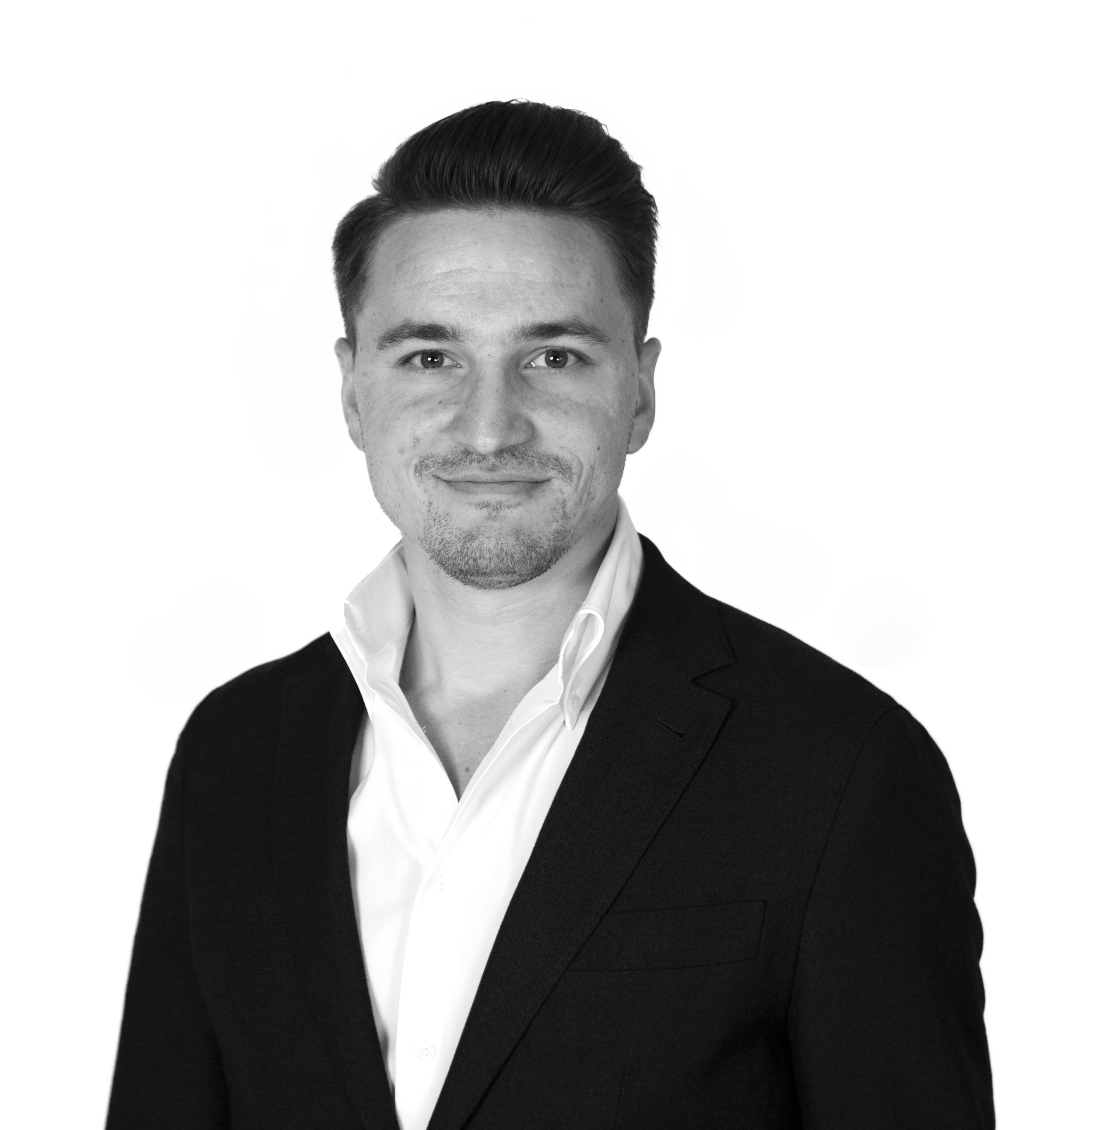

DANIJEL GOGA
International Business manager
Notes:
My name is Danijel Goga and i would like to thank you for your time and listening to me.
If you have any questions please let me know, I am here together with our distributor Stamed who handles the market in Czech Republic.
Stand:

